Slide 1
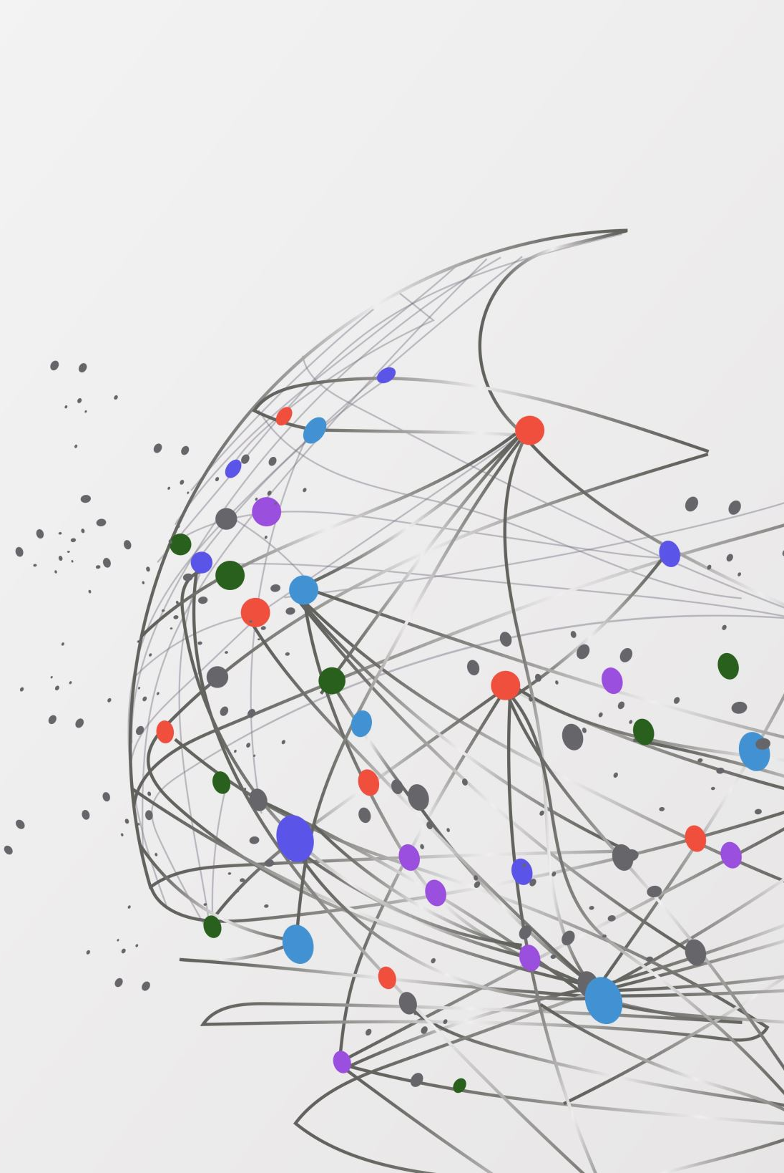
Environmental Impact from Cybersecurity Measures
In terms of Energy Consumption and carbon emissions

Slide 2
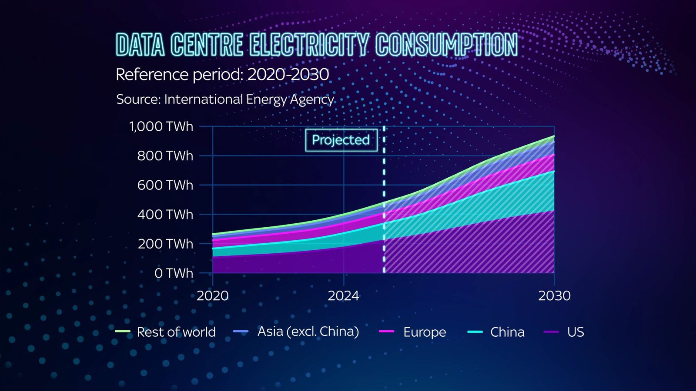
FACTORS
Data Centre Powers and Cloud Computing
Requires huge electricity to run data centers along with cloud computing.
Cooling system uses more energy and carbon emissions if fossil fuel is used to power the center.
1-2% of glabal electricity supply is used.
Backup power supply and disaster recovery system demands more energy.
Use of AI has given rise to the energy demand significantly in data centers
Constant uptime for Cloud computing with high performance servers demands energy for each second.

Slide 3

Factors
2. Encryption and Security Processes
Increased CPU usage as requires more processing power for strong encryption
Constant monitoring is required for multi-factor authentication demanding constant energy feeding.
Recovery efforts amplify energy consumption globally with carbon emissions rising as well.
Any updated hardware gives rise to electronic waste if the used hardware is deemed compromised.

Slide 4

Factors
3.Electronic Waste:
Upgrading hardwares like firewalls, servers and network devices create a pile of electronic device wastage.
Release of hazardous substances like mercury, lead.
Soil fertility is damaged limiting plant growth
Burning such E-waste releases toxic chemicals to air.

Slide 5
Prevention
Use of energy efficient appliances
Use of Data Centers with low power usage effectiveness
Solar Powered security systems could be the best choice for low emissions.
Proper recycling reduces e-waste from having effect on environment.
Adoption of Sustainable cybersecurity policies & law.
Green IT principles such as use of renewable energy, low power consumption and lower carbon emitting systems.

